Slide 1

Introduction to
Bhavesh Anand
G.B Pant University of Agriculture and Technology, pantnagar

Slide 2
Outline
Background
Syntax
Types / Operators / Control Flow
Functions

Slide 3
Background

Slide 4
Multi-purpose (Web, GUI, Scripting, etc.)
Object Oriented
Interpreted
Strongly typed and Dynamically typed
Focus on readability and productivity

Slide 5
Syntax

Slide 6

Hello World

Slide 7
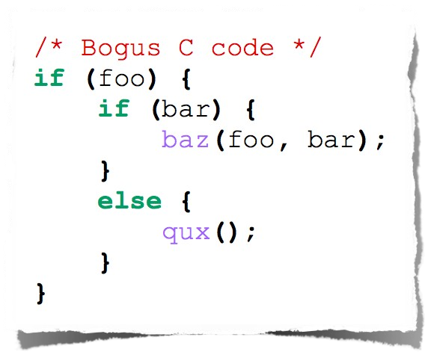
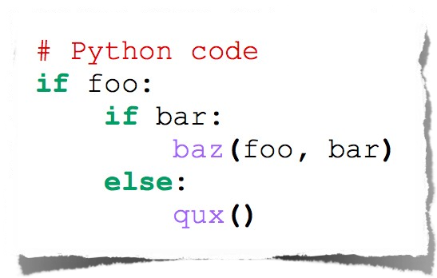
Indentation

Slide 8
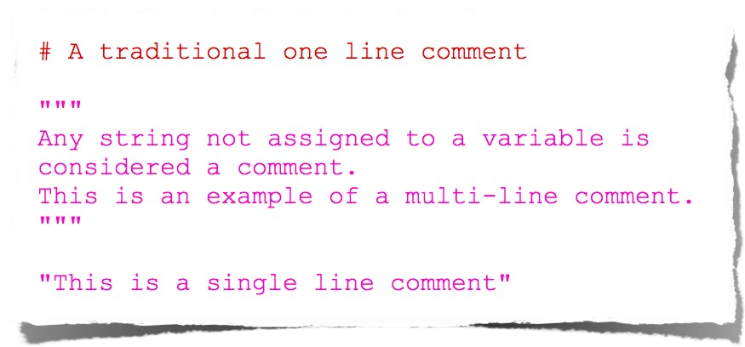
Comments

Slide 9
Types

Slide 10
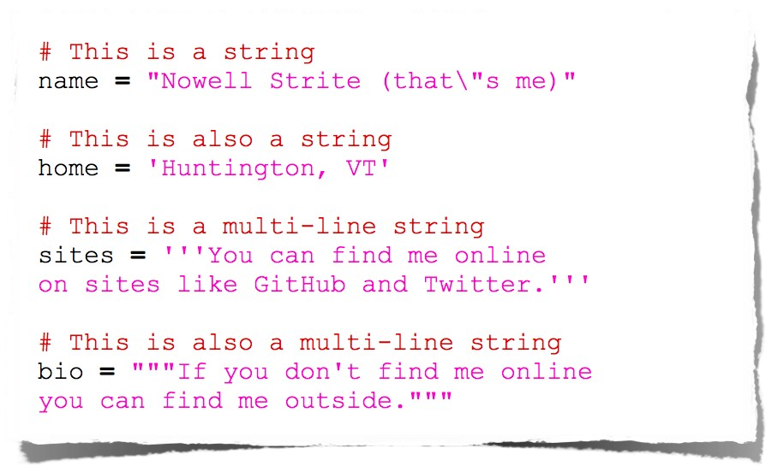
String

Slide 11
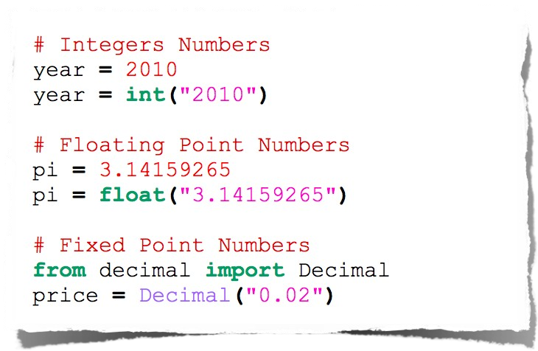
Number

Slide 12

Null

Slide 13
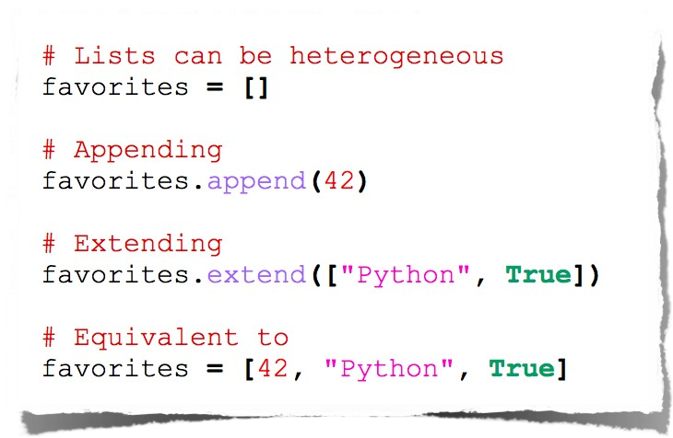
List

Slide 14
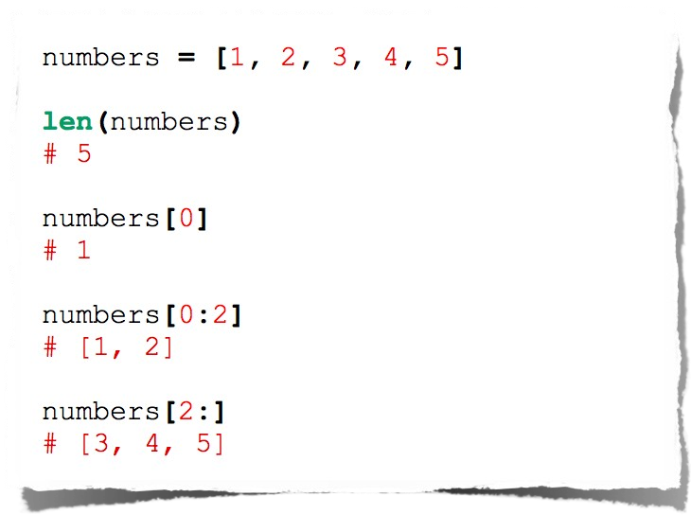
List

Slide 15
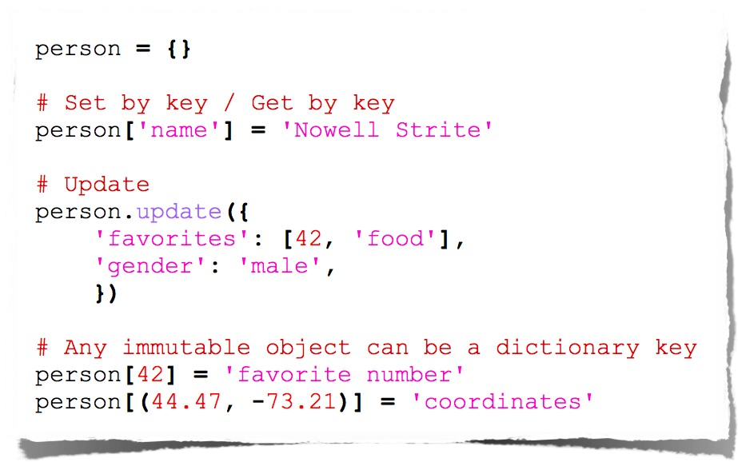
Dictionaries

Slide 16
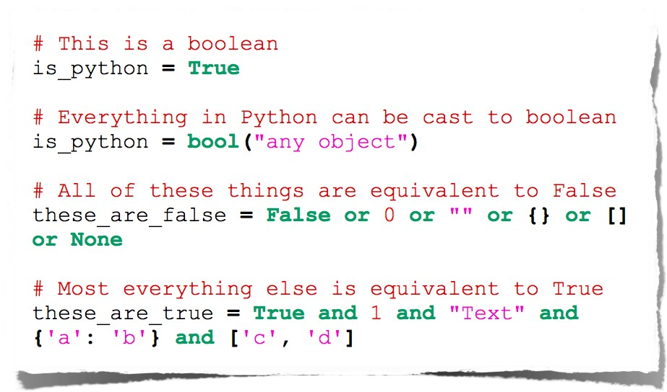
Booleans

Slide 17
Operators

Slide 18
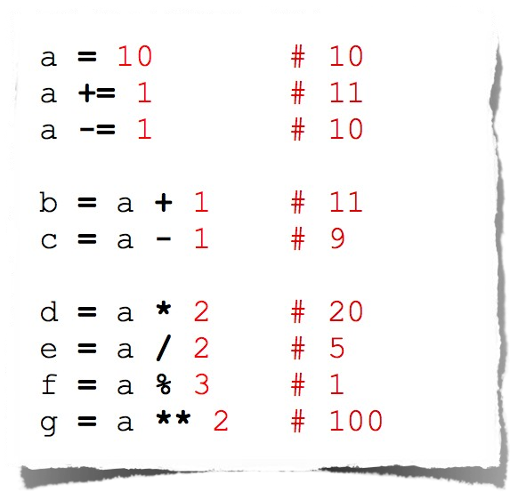
Arithmetic Manipulation

Slide 19
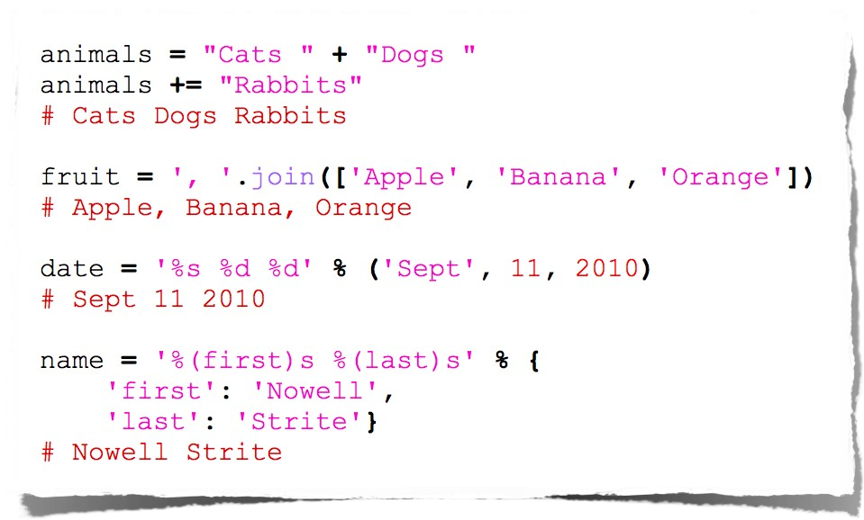
String Manipulation

Slide 20
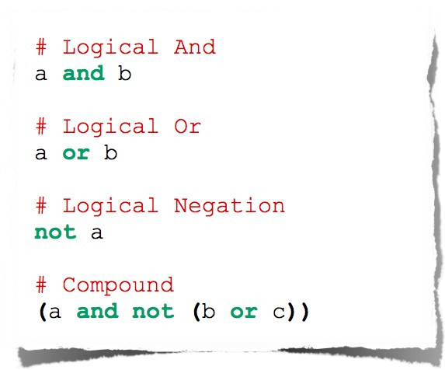
Logical Comparison

Slide 21
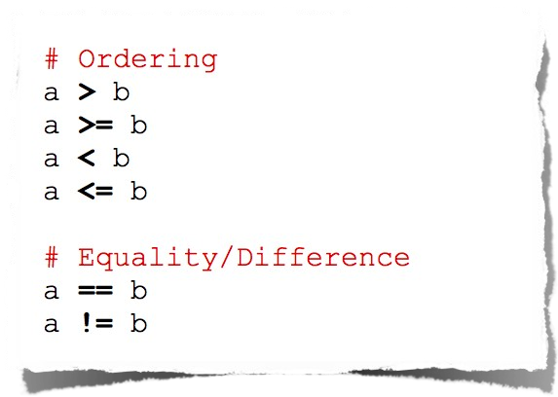
Arithmetic Comparison

Slide 22
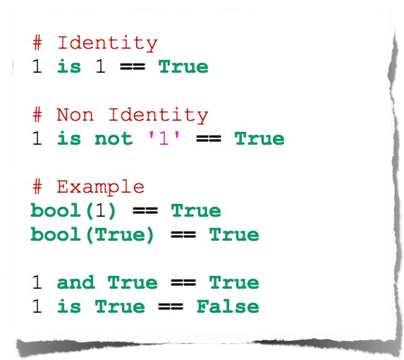
Identity Comparison

Slide 23
Control Flow

Slide 24
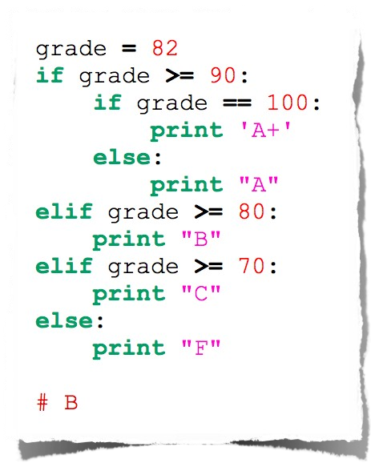
Conditionals

Slide 25

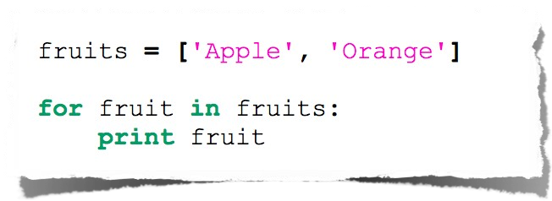
For Loop

Slide 26
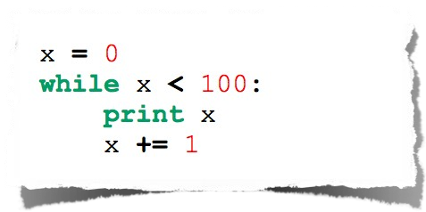
While Loop

Slide 27
Functions

Slide 28

Basic Function

Slide 29
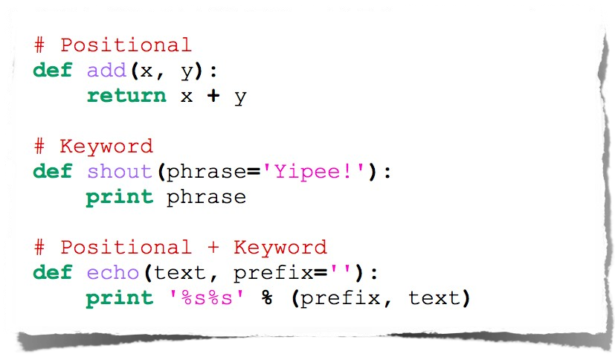
Functions with arguments

Slide 30
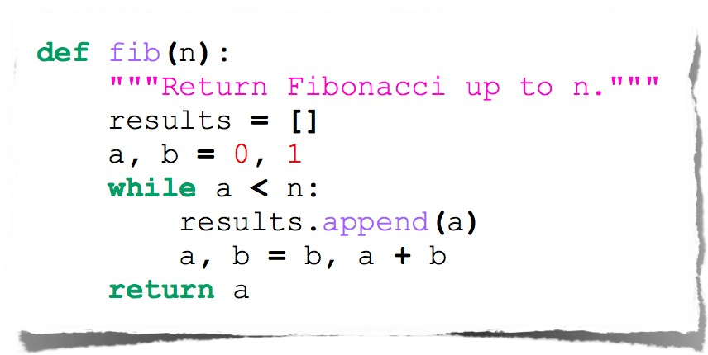
Fibonacci

Slide 31
Thank you

